Slide 1
Online Payment 101 for Merchants
Don’t waste your precious revenue
Nguyễn Sơn Tùng
CTO & Co-founders - VIEC.CO

Slide 2
Our Journey Today
Getting Started
Optimization
Choosing Payment Options and Vendor
Several tips for boosting revenue
02
04
Getting To Know
03
Operation
01
Providing support
Managing risks

Slide 3

Getting To Know
HELLO!
5 years working at TIKI
Head of Technology & Payment Team Lead
Significant payment improvement
Now, I’m working at VIEC.CO
Notes:
I had a short time working in VXR, introduced Cash on Presence
Now I work for a startup Viec.Co with my friend as co-founder, seeking for pay salary/bonus for hundred thousands to millions blue-collar workers

Slide 4
Some of User Experience

Slide 5
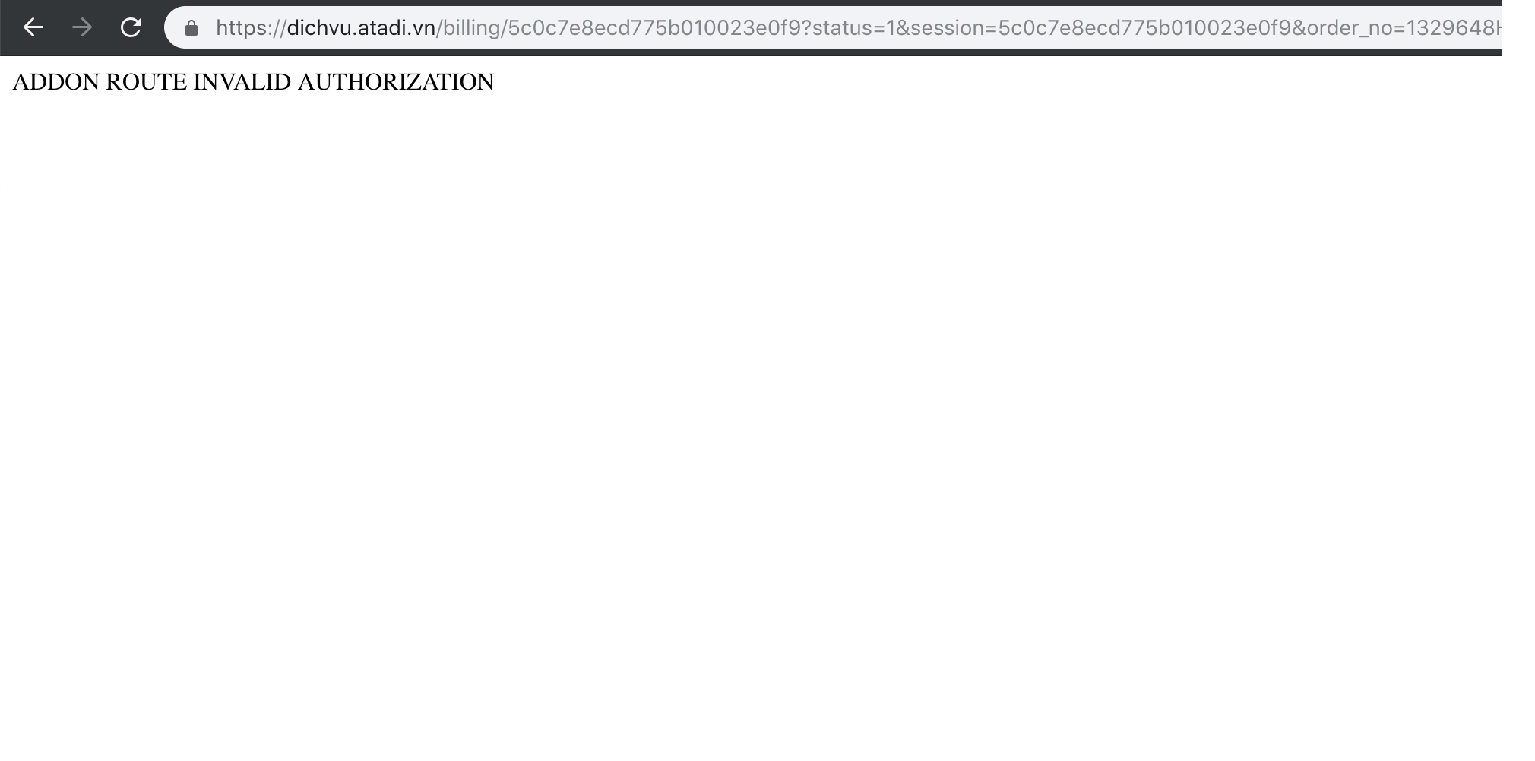
Ready to Pay?

Slide 6
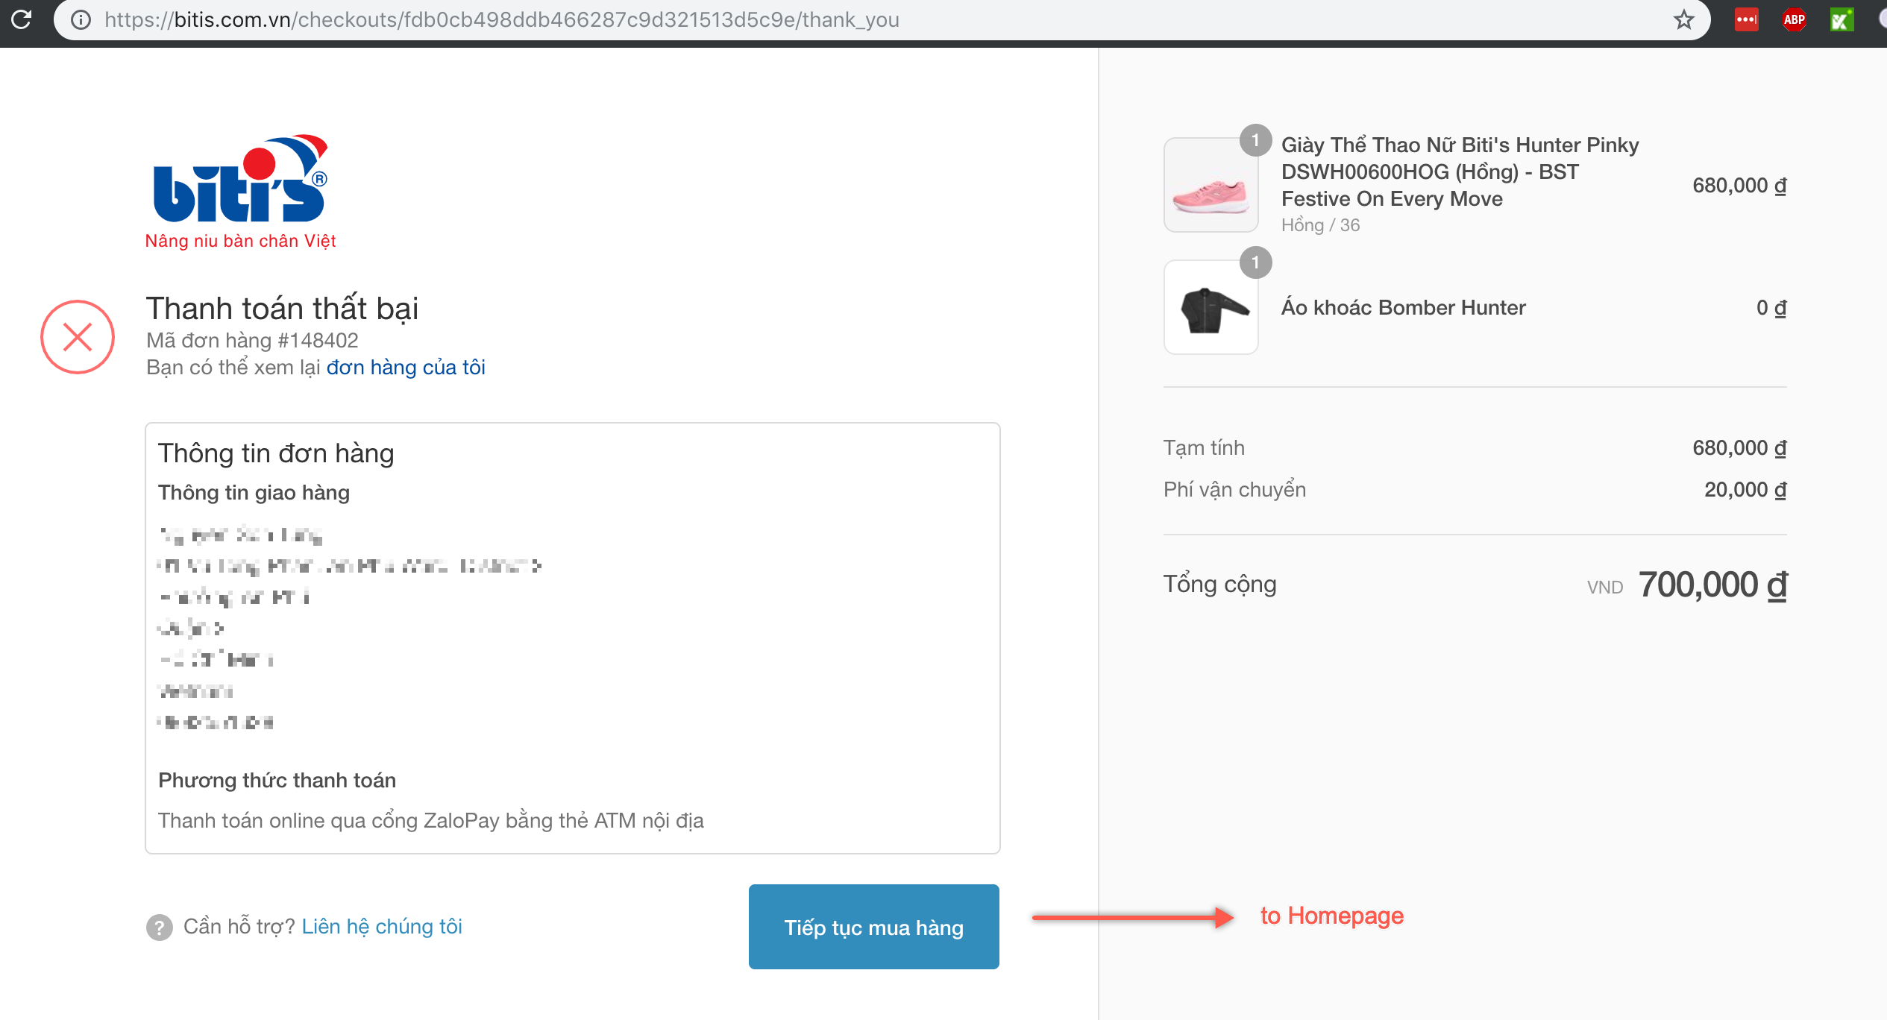

Slide 7



Lower Order Cancellation Rate
Better Cash flow
WHY DOES IT MATTER?
Marketing
Landing page CR
Checkout CR
Payment CR
Sales Funnel
Notes:
2 major issues:
Online Payment usage’s increasing (higher CR, lower cancellation rate, better cash flow)
Bottom sales funnel

Slide 8

Who Are You?
Not yet on board
Up and running
COD, Bank Transfer
Already allowed pay by cards
Don’t know where to start, who to contact
Why is failure rate so high?
Which Vendor is good?
Payment fee is destroying me
Am I safe?
Notes:
Bên nào tốt? nhiều lựa chọn (logo)
Chất lượng?
Phí thấp, thu tiền nhanh
Mô hình hoạt động ntn?
Làm sao nhập thẻ trực tiếp?
Rủi ro bảo mật? Cần chứng chỉ gì?
Don’t know where to start

Slide 9
Let’s Get Started

Slide 10
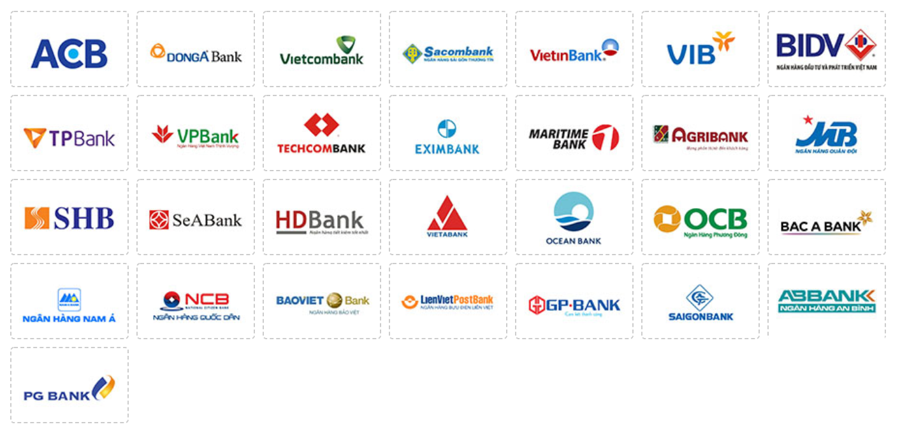
Choosing Payment Methods
Classification by Source of Money
Internet Banking, ATM, Prepaid Card
Source of Money
International Cards
Wallets
Notes:
Show Demonstration flows
Also apply for reconsidering

Slide 11


Choosing Payment Methods
Classification by type of integration
Onsite + External Form Submission
Onsite + Self- Submission
Redirection
Notes:
Show Demonstration flows
Also apply for reconsidering

Slide 12
Choosing Payment Methods
Redirection
Recommend for new site
Pros:
Quick implementation
Cons:
Custom UI/Brand
Error rate consideration

Slide 13
Choosing Payment Methods
Onsite + External Form Submission
Recommended in most cases
Pros:
Safe (no card data is stored)
PCI/DSS is not required
Custom UI (Brand)
Cons:
Require Payment knowledge
Higher cost for integration, operation

Slide 14
Choosing Payment Methods
Onsite + Self Submission
Recommended for large-scale entities
Pros:
Self-control everything = Better change for improvements
Cons:
PCI/DSS level 1 is required
Highest cost, risks

Slide 15



Choosing Vendor
List of Vendors
Domestic Gateways
International
Wallet
Notes:
Also apply for reconsidering

Slide 16
Choosing Vendor
Factors for consideration
1
Coverages
2
Product (Features, UX)
3
Pricing structure
Notes:
Also apply for reconsidering
Coverage
Fee
Product (Features, UX)

Slide 17

Choosing Vendor
Coverages
Internet Banking, ATM, Prepaid Card
Missing
Missing
All included
Pvcombank, PNB, VRB, IVB,…
ACB, OCB,
LietvietPostbank, Pgbank,…

Slide 18
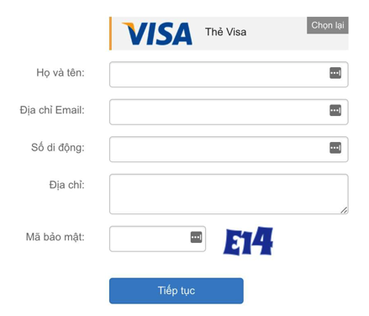

Choosing Vendor
Product, UI
Tokenization
Transaction status: QueryDR, IPN
Auto-Refund
UI, UX
Features

Slide 19
Choosing Vendor
Pricing structure
Monthly fixed fee
Transaction fee
Processing fee, Refund fee
On us vs Off us
Features fee (Tokenization)
Transaction based fee
Wallet
ATM
VISA/Master
Up to
1.x%
3.x%

Slide 20
Choosing Vendor
Multiple Vendors
How about implementing multiple vendors + Payment Routing?
Router
Bank
Performance
Cost

Slide 21
Recommendations
NEW TO PAYMENT
ALREADY IMPLEMENTED
Easy starting
Known your data => Optimization (Success Rate, Cost)
Notes:
If haven’t included in previous parts

Slide 22
Operation

Slide 23
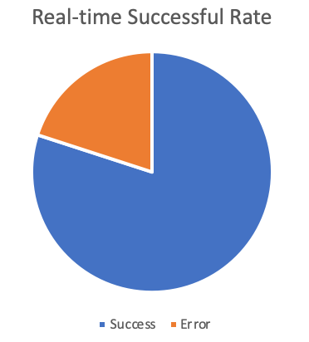
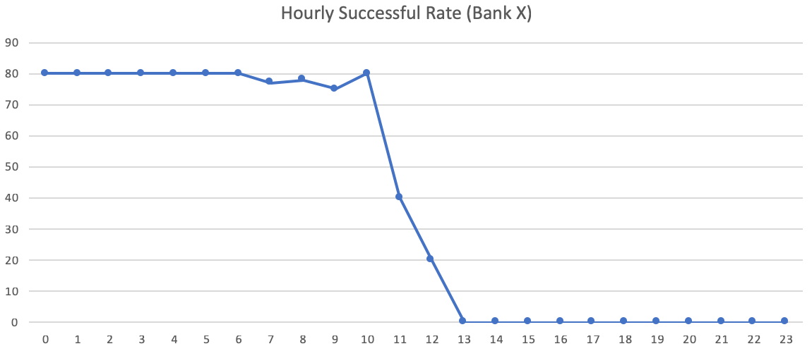
Monitoring
Dashboard and Alerts are your friend
Notes:
What do I have to do?
Support Team
Transaction Processing, Refund, Auto & Partial Refund
Manage risks
Monitor

Slide 24

Support Team
Clear cache
Restart browser
Restart computer
Knowledge base, FAQs
Vendor, Bank support
Be helpful

Slide 25
Managing Risks
Chargeback

Slide 26

Managing Risks
Avoiding chargeback
Always request Proof-Of-Delivery (POD)
OTP
Enable 3DS for high-value transaction
10,000,000 đ
100,000 đ
trusted customer

Slide 27
Revenue Optimization

Slide 28
Improving Success Rate
What’s your success rate?
90%?
80%?
60% or lower?

Slide 29
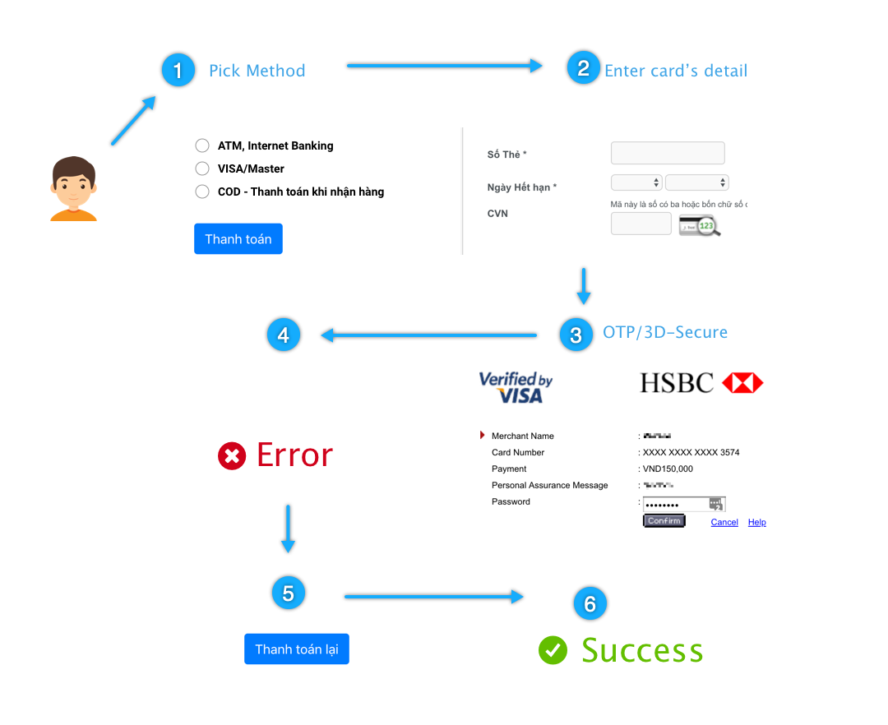

Improving Success Rate
Depends on how we define Conversion
Any steps can be dropped
Internet disconnection
User aborts
Bank rejects
Lack of retries
Payment Vendors tend to define Success Rate from step 2-3 to 4
Good understanding => Improvements

Slide 30
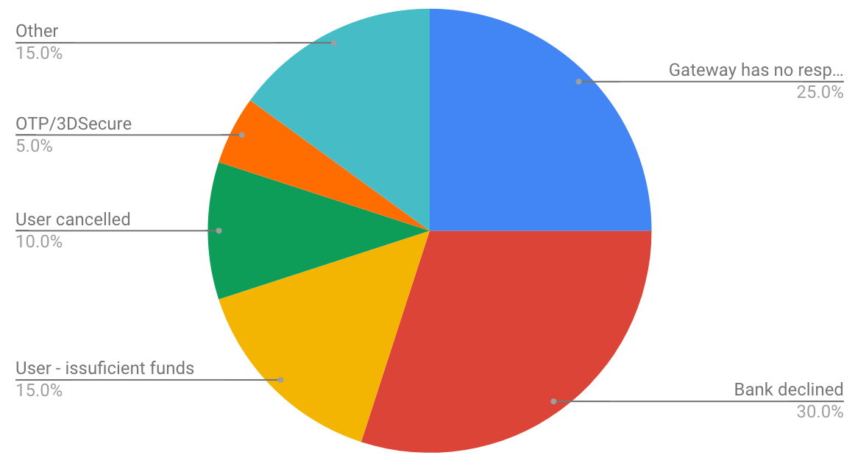
Understanding Payment Errors
Common Payment Errors
Classification and targeted optimization
Gateway
Bank
User
(Based on my experience, no actual data is provided)

Slide 31
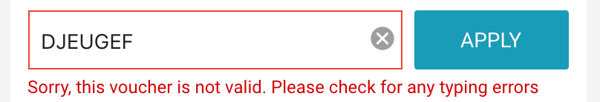
Improving Success Rate - Suggestion UI
Bad Case
but when the customer places a new Order
What am I suppose to do next?
Arggg!

Slide 32
Improving Success Rate - Suggestion UI
Improvement – Be specific and keep your Order alive
Be specific
Be helpful
Keep your precious order alive

Slide 33
Save card, Recurring, Subscription
By using Tokenization

Slide 34
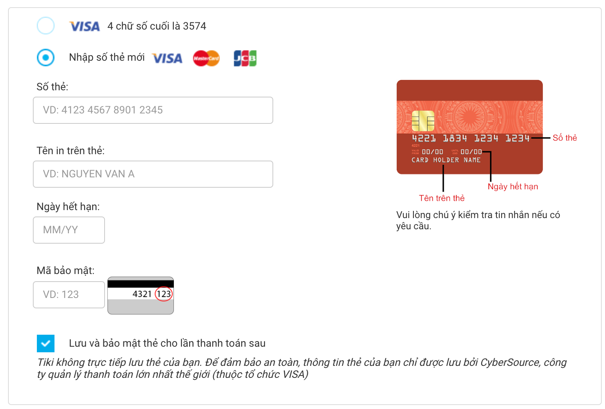
Save card, Recurring, Subscription
By using Tokenization
Saved card
Adding a new one
Tiki.vn Payment UI

Slide 35
Save card, Recurring, Subscription
By using Tokenization – How it works
Safe & Convenient

Slide 36

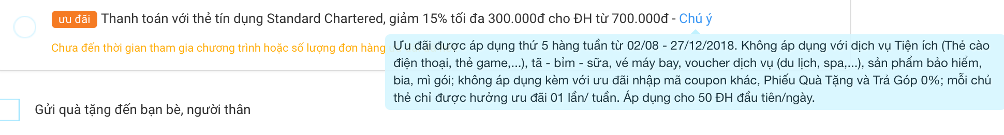
Payment Promotion and Installment

Slide 37
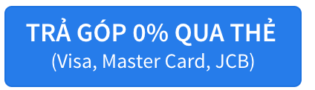
Payment Promotion and Installment
21.500.000đ
-2.150.000đ
19.350.000đ

Slide 38
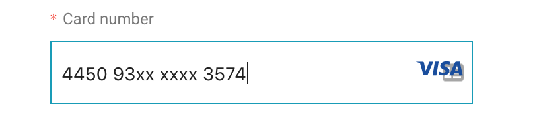
Payment Promotion and Installment
How it works
VISA
HSBC Vietnam
BIN – Bank Identification Number

Slide 39
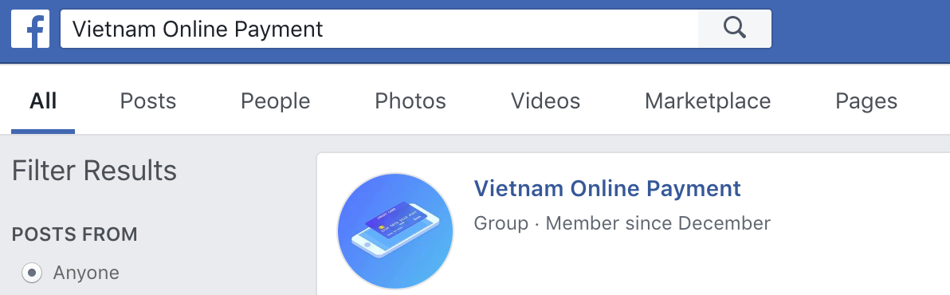
Conclusion & What’s Next
Conclusion & What’s Next
You’re invited!
Connect/Contact
QnA, kinh nghiệm sử dụng
Business: Trả góp, Promotion
Các tính năng: Tokenization, Refund, Retry, Qr,...
Bảo mật, 3DSecure/OTP. Fraud.
UI/UX
Technical document/solution. GitHub SDKs
Notes:
To increase revenue:
Implement appropriate method and vendor
Avoid high error rate
Be safe

Slide 40
Thank you
Get in touch
tung@viec.co
0939221182
facebook.com/tungns

